Slide 1
AMIRIS Germany2027
Progress Report: From Brainpool's 2027 Data to a Calibrated Model
Muideen Oladayo Ajiboye | 17 August 2026

Slide 2
Executive Summary
• Built a full AMIRIS Germany2027 scenario from Brainpool's real 2027 data (capacities, demand, fuel/carbon prices)
• Refined the demand model (V1 -> V2) and added cross-border imports
• Obtained Brainpool's own real 2027 hourly price forecast and ran the first AMIRIS-vs-Brainpool comparison
• First result looked alarming: AMIRIS's average price was 3-7x higher than Brainpool's
• Diagnosed the real cause, fixed it, and calibrated it - AMIRIS's price forecasts now land close to Brainpool's own numbers
Build | Shortage hours (before -> after) | Mean price (before -> after)
V1, with-import | 11.78% -> 0.83% | 400.04 -> 75.46 EUR/MWh
V2, with-import | 5.35% -> 0.03% | 219.81 -> 57.34 EUR/MWh
Brainpool's own real 2027 forecast | 0.00% (reference) | 68.04 EUR/MWh (reference)
AMIRIS Germany2027 Progress | 2

Slide 3
The Four Model Versions
Two demand models x two cross-border assumptions - referenced throughout everything that follows
No cross-border trade
With cross-border trade (ImportTrader)
V1
BDEW demand: one household profile applied to the WHOLE economy's demand
V1, no-import
The first, simplest build.
Shortage hours: 15.88%
Mean price: 519 EUR/MWh
V1, with-import
BDEW demand + import added.
Final ceiling: 37,650 MW (flat)
Shortage hours: 0.83%
Mean price: 75 EUR/MWh
V2
Component-split demand: real base load + heat-pump + electrolysis + EV shapes
V2, no-import
Refined demand, no import.
Shortage hours: 7.52%
Mean price: 286 EUR/MWh
V2, with-import (FINAL)
Refined demand + import,
calibrated. Ceiling: 30,000 MW
Shortage hours: 0.03%
Mean price: 57 EUR/MWh
Closest to Brainpool's real
forecast of 68 EUR/MWh

Slide 4
Phase 1: Data Sources & Gap Resolution
Gap | How it was resolved
Outages / must-run rates | AMIRIS's own validated historical (2015-2019) data, redated to 2027
Wind offshore profile | AMIRIS's own data, cross-checked against renewables.ninja
Renewable subsidy rates | Researched from real EEG / BNetzA auction sources
Battery storage duration | Researched from MaStR (Marktstammdatenregister) project data
Cross-border trade | Initially assumed zero; built as a separate variant later (Phase 5)
Every input traced to one of four labels:
Brainpool (direct) / Brainpool (converted) / AMIRIS's own validated data / real external research - kept consistent through the whole build for auditability.
AMIRIS Germany2027 Progress | 5

Slide 5
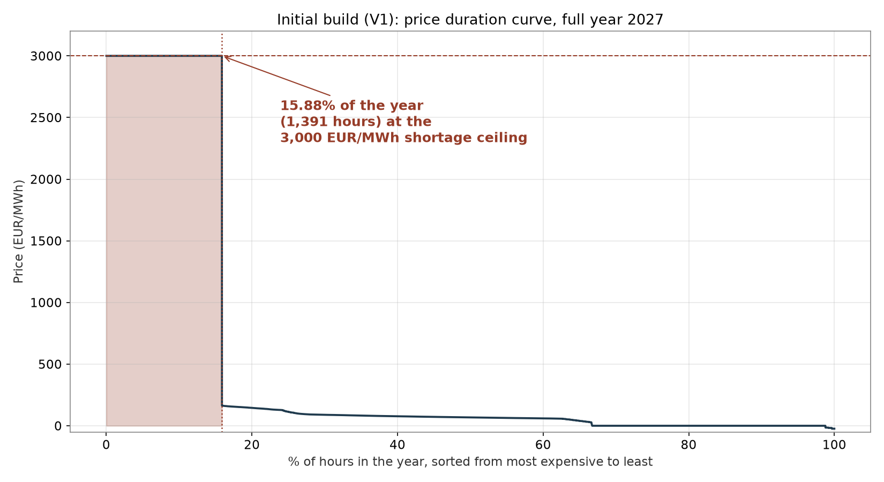
Phase 2: Initial Build (V1)
• This is a price DURATION CURVE: every hour of the year, sorted from most to least expensive
• The flat plateau at 3,000 EUR/MWh is AMIRIS's shortage ceiling - the price it assigns whenever the market can't fully meet demand
• 1,391 of 8,760 hours (15.88%) sit on that plateau
• This is what "shortage pricing hit 15.9% of the year" actually looks like
AMIRIS Germany2027 Progress | 6

Slide 6
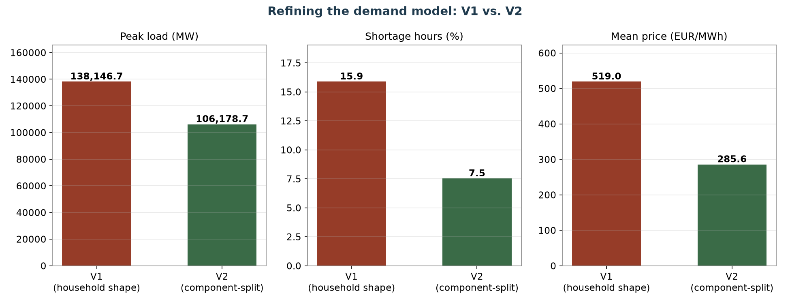
Phase 3: Refining the Demand Model (V1 -> V2)
AMIRIS Germany2027 Progress | 8

Slide 7
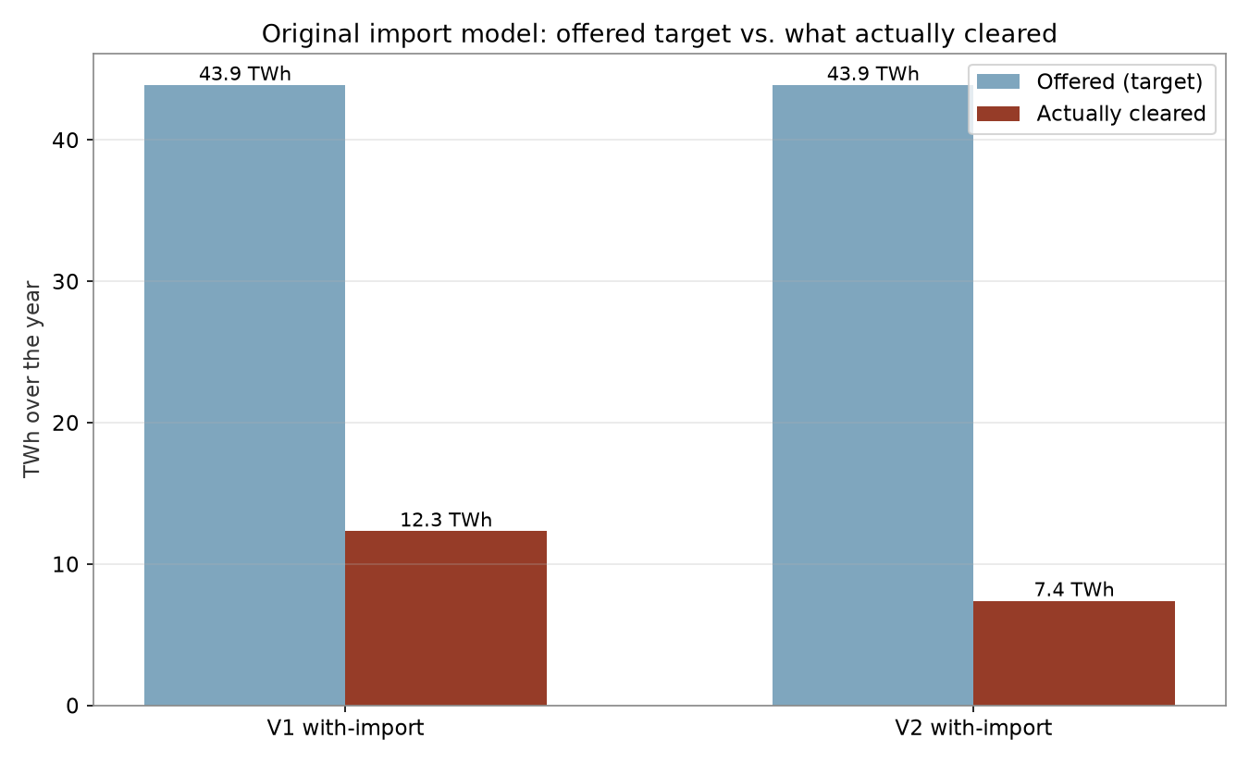
Phase 4: Adding Cross-Border Imports (First Attempt)
• Both demand versions got an ImportTrader offering Brainpool's 43.90 TWh net-import figure
• Priced at real 2023 French day-ahead prices
• Helped reduce shortage hours further - but only a small fraction of the offered volume ever actually cleared
• V1: 28% cleared. V2: only 17% cleared
• At the time, this was reported as a market-clearing finding, not yet identified as something broken
AMIRIS Germany2027 Progress | 9

Slide 8
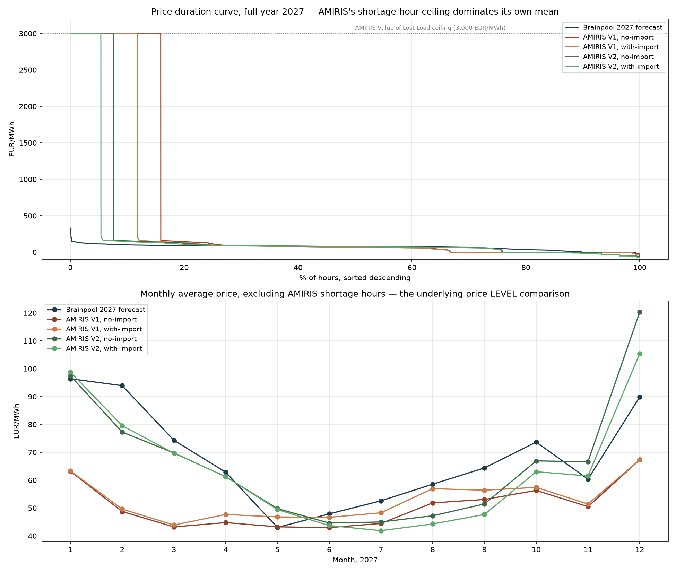
Phase 6: Comparing Against Brainpool's Real 2027 Price
AMIRIS Germany2027 Progress | 10

Slide 9
The Gap Was Not What It Looked Like
Build | AMIRIS mean price | Brainpool mean price | Ratio
V1, no-import | 519.02 | 68.04 | 7.6x
V2, with-import (original) | 219.81 | 68.04 | 3.2x
The "average salary" problem:
A small number of extreme shortage hours (priced at 3,000 EUR/MWh) drag the whole-year average up - just like one very high salary skewing a company's average pay. It doesn't mean everyone earns that much.
Excluding those hours, the picture flips:
V2's price level on ordinary (non-shortage) hours was already close to Brainpool's - mean of 64.76 EUR/MWh vs. Brainpool's 68.04, a gap of well under 1 EUR/MWh (bias -0.39). The disagreement was never really about price level - it was about how often the model thought Germany ran short of supply.
AMIRIS Germany2027 Progress | 11

Slide 10
Phase 8: The Fix - Decouple Imports from Historical Timing
• Replace the shaped, often-zero import series with a FLAT, constant hourly ceiling
• No historical timing pattern involved at all
• The real French price series still decides, hour by hour, how much actually clears
• No annual import total is pre-targeted - the realized volume is a genuine market outcome
First pass: flat 37,649.98 MW (the real observed 2023 peak import hour)
Eliminated V2's shortage hours completely (0.00%) - but overshot Brainpool's average price (bias -12.59 EUR/MWh). The ceiling was generous enough to also flood many ordinary hours with cheap import.
AMIRIS Germany2027 Progress | 13

Slide 11
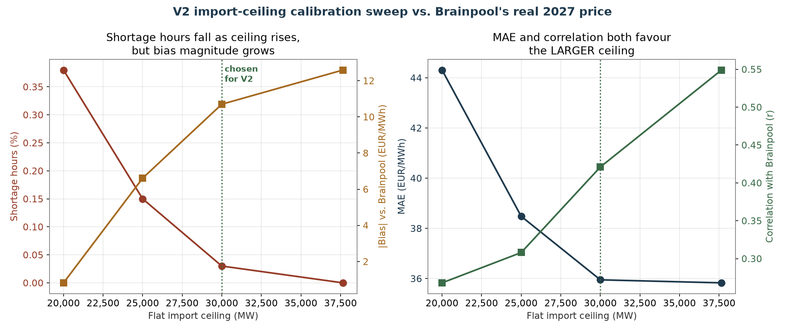
Calibrating the Ceiling: a Real Trade-Off
AMIRIS Germany2027 Progress | 14

Slide 12
Bias Alone Would Have Picked the Wrong Ceiling
• 20,000 MW looks best on bias (+0.82, nearly zero)
• But bias can hide a lot: positive and negative hourly errors cancel out even when the underlying tracking is poor
• MAE (which doesn't let errors cancel) and correlation both say the SMALLER ceilings are actually LESS reliable hour to hour
• 30,000 MW chosen for V2: MAE and correlation nearly match the most generous ceiling, shortage hours are essentially eliminated, and bias is meaningfully improved
Ceiling | Shortage hrs | Bias | MAE | Correlation
20,000 MW | 0.38% | +0.82 | 44.31 | 0.268
25,000 MW | 0.15% | -6.61 | 38.48 | 0.308
30,000 MW (chosen) | 0.03% | -10.70 | 35.95 | 0.421
37,650 MW | 0.00% | -12.59 | 35.83 | 0.549
AMIRIS Germany2027 Progress | 15

Slide 13
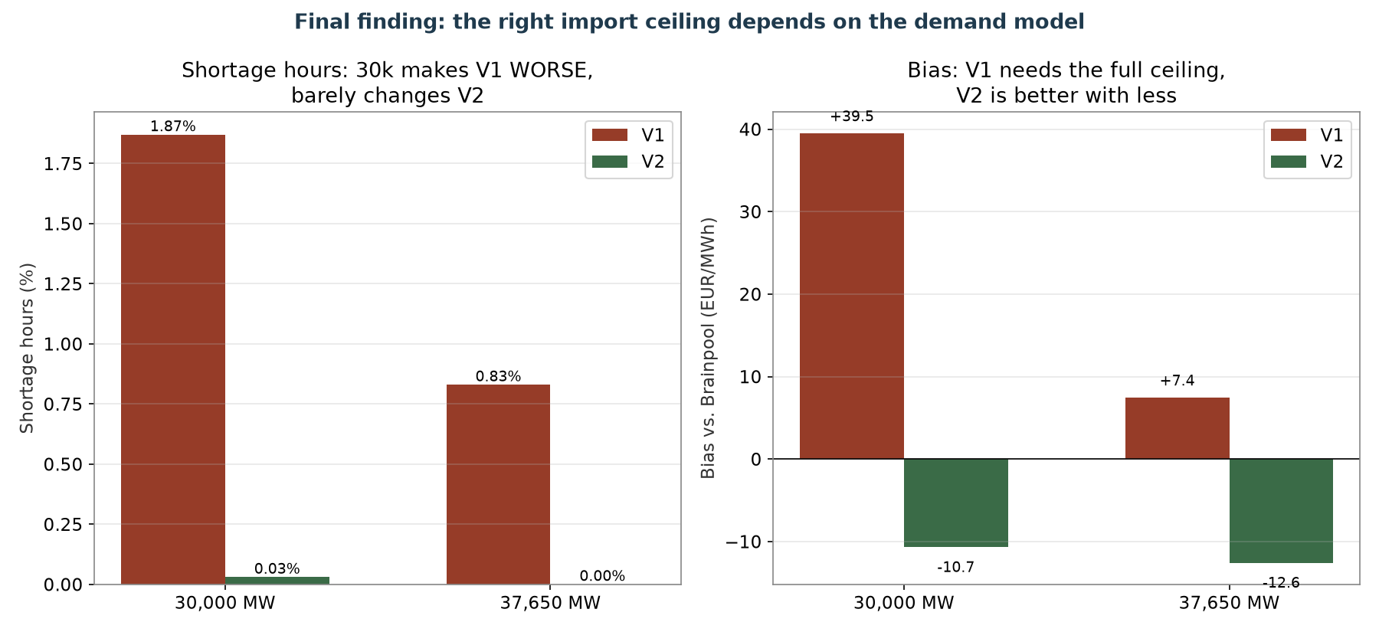
A Further Finding: V1 and V2 Need Different Ceilings
AMIRIS Germany2027 Progress | 16

Slide 14
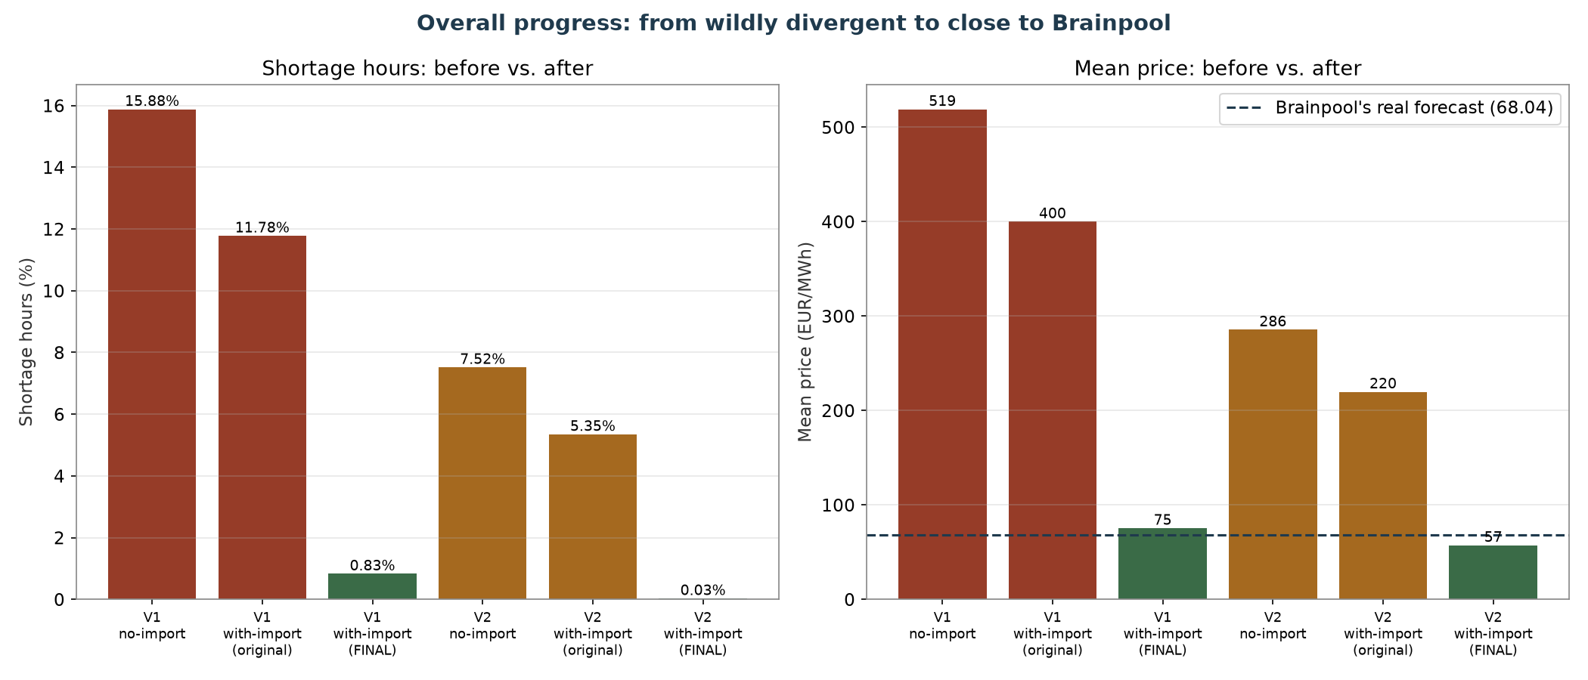
Where Things Stand Now
AMIRIS Germany2027 Progress | 17

Slide 15
Next Steps
• Validate out-of-sample: build Germany2028 the same way, apply the same calibrated import approach WITHOUT re-tuning it, and check the fit against Brainpool's real 2028 price
• Build the with-import variant as a completed comparison set for both demand versions vs. Brainpool
AMIRIS Germany2027 Progress | 18

Slide 16
Thank you
Questions & discussion

